Slide 1
Biology 100 Spring 2016 Analysis

Slide 2
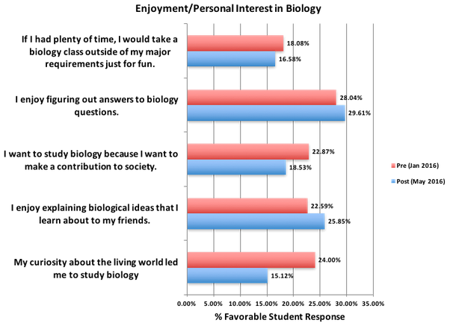
Pre/Post Course Survey
Student responses to questions regarding enjoyment and personal interest in biology

Slide 3
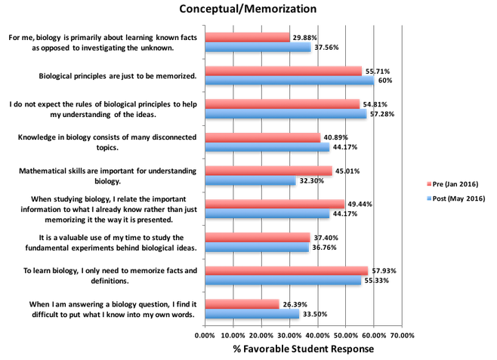
Pre/Post Course Survey
Student responses to questions regarding concepts and memorization of biology

Slide 4
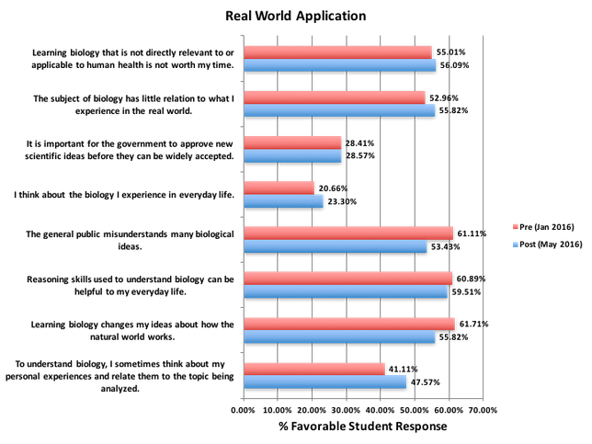
Pre/Post Course Survey
Student responses to questions regarding real world application of biology

Slide 5
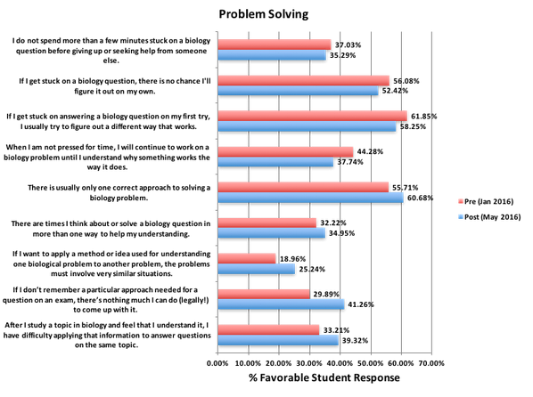
Pre/Post Course Survey
Student responses to questions regarding problem solving in biology

Slide 6
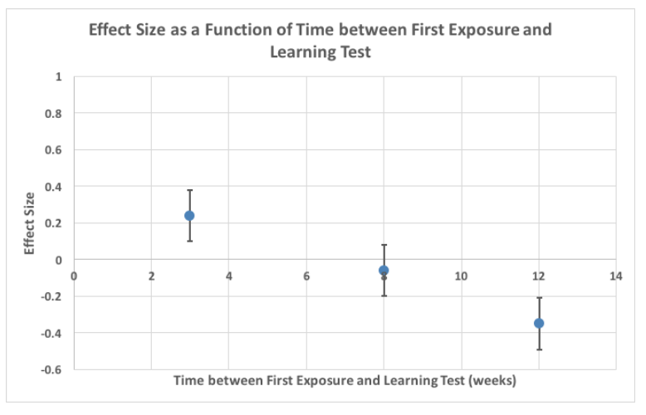
Effect Size of Retention of Material
Effect size of retention of material tested as a function of the time between the initial test and the learning test

Slide 7
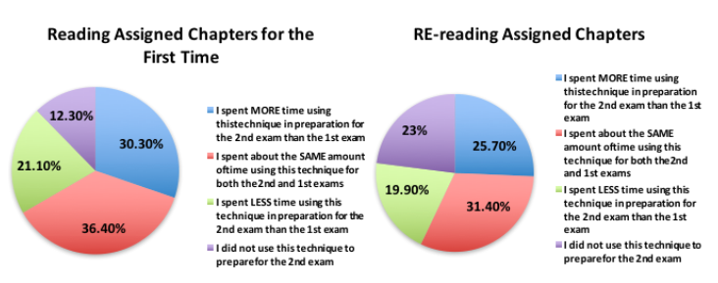
Exam Wrapper Part 1

Slide 8
Exam Wrapper Part 1

Slide 9
Exam Wrapper Part 1

Slide 10
Exam Wrapper Part 1

Slide 11
Exam Wrapper Part 1

Slide 12
Exam Wrapper Part 1

Slide 13
Exam Wrapper Part 1

Slide 14
Exam Wrapper, Part 2
Student responses to questions about the group portion of the exam

Slide 15
Exam Wrapper, Part 2
Student responses to questions about the group portion of the exam

Slide 16
Exam Wrapper, Part 2
Student responses to questions about the group portion of the exam

Slide 17
Exam Wrapper, Part 2
Student responses to questions about the group portion of the exam

